Slide 1
SOCIAL ENGINEERING -
LACK OF PUBLIC PARTICIPATION
A much ignored reason behind the failure of drives to spread awareness about environmental conservation in India is the lack of public participation.

Slide 2
INTRODUCTION
Public participation refers to various types of activities that are used to incorporate people’s interests, concerns, needs, and values into decisions and actions on public issues.
Environmental conservation awareness campaigns work by sharing factual information about the issue at hand.
Without public participation, the medium to convey this information is lost.

Slide 3
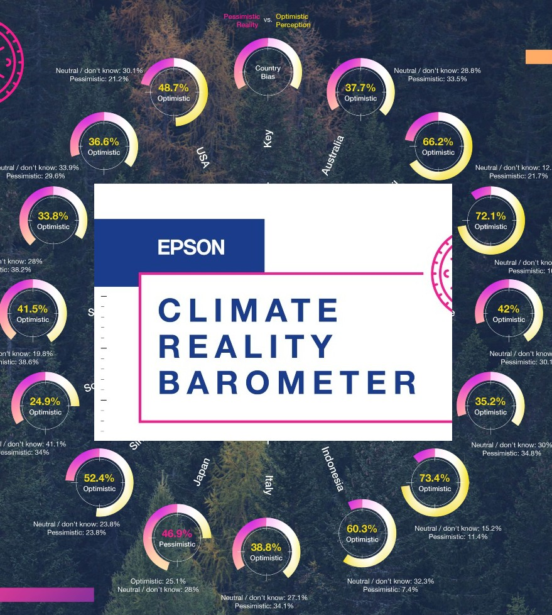
HOW PUBLIC PARTICIPATION IMPACTS THE SUCCESS OF AWARENESS DRIVES
In a recent survey conducted known as Epson Climate Reality Barometer, it was found that Indians displayed a lack of consistency between individual intention and action.
8.8 per cent said they had no intention of reducing plastic use, or did not know how to.
16.7 percent of those surveyed said they did not intend to boycott unsustainable brands.
8.9 percent said they did not intend to change their travel habits, i.e., switching to walking or cycling.
Therefore, an unwillingness to participate in bettering the environment can be seen through this survey which correlates to the lack of public participation.

Slide 4
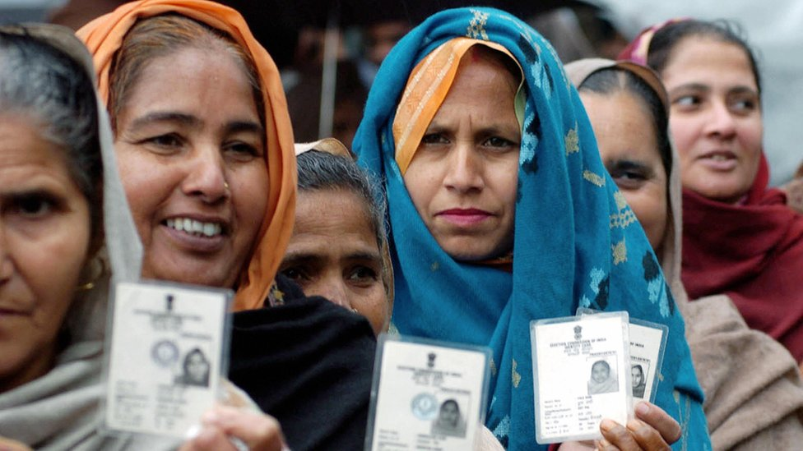
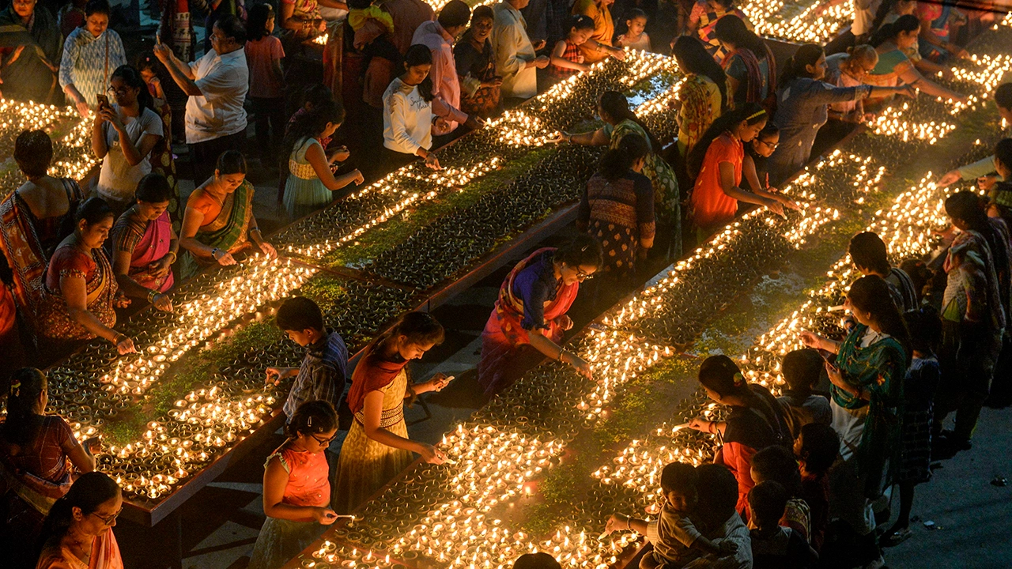
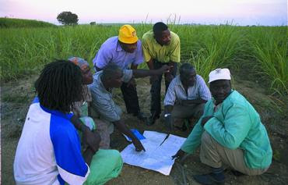
HOW DOES PUBLIC PARTICIPATION EXACTLY WORK?
Let’s take a look at the different types of Public Participation.
POLITICAL
RELIGIOUS
“A COMMON PURPOSE”

Slide 5

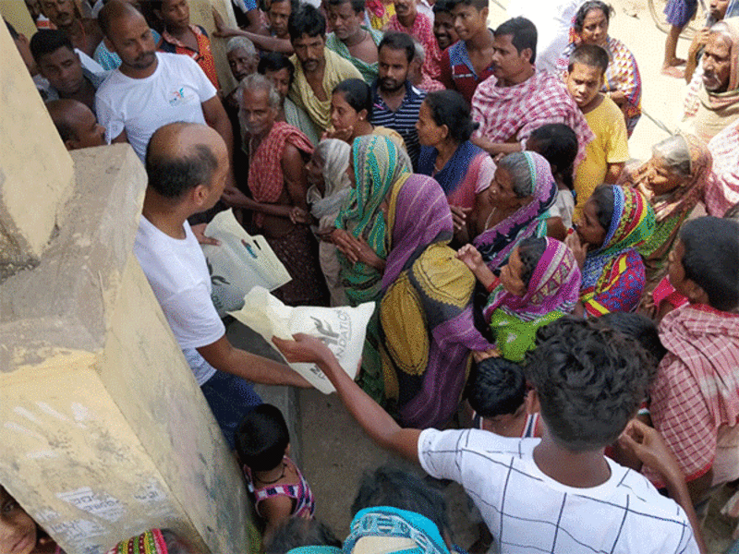


HOW DOES PUBLIC PARTICIPATION EXACTLY WORK?
“A Common Purpose” Public Participation.
TRADING
NGO DRIVES
CHIT FUNDS
ENVIRONMENT RELATED

Slide 6


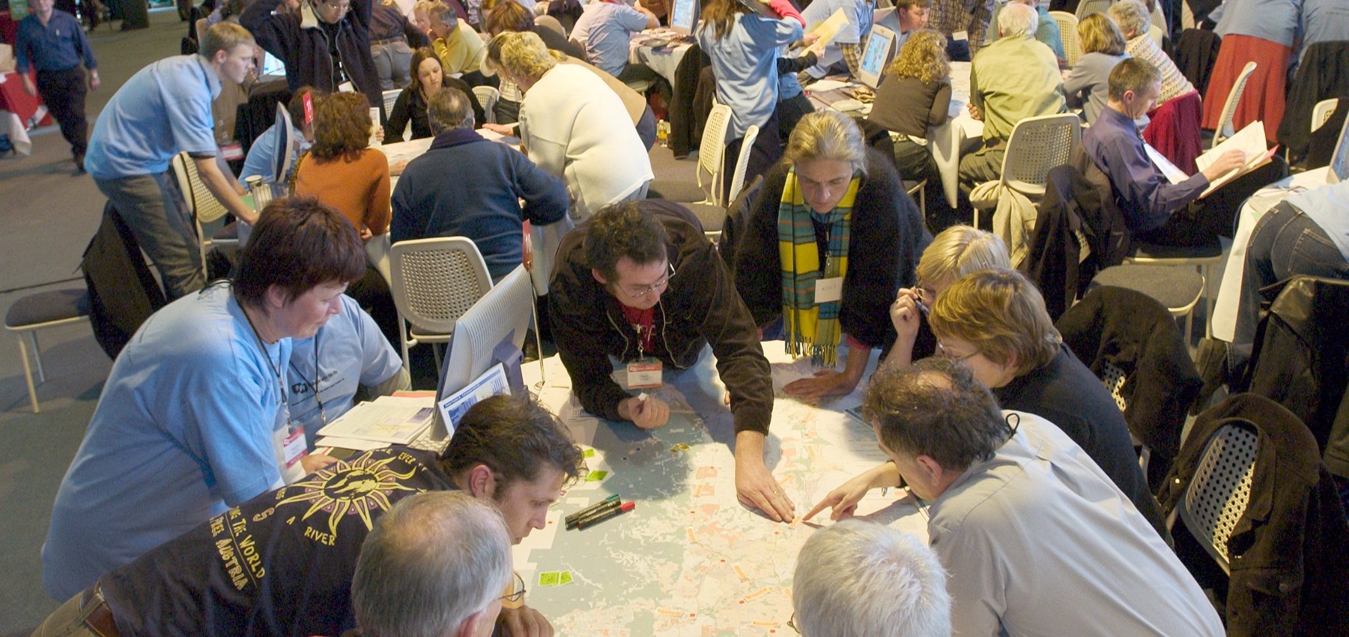
HOW DOES PUBLIC PARTICIPATION EXACTLY WORK?
What is the importance of Public Participation?

Slide 7
WHY IS THERE A LACK OF PUBLIC PARTICIPATION?
Public participation is sometimes constrained by many factors. Exploring the reasons behind the obstruction of the implementation of the public participation process is an important approach to the achievement of effective participation and better results. We analyse the internal and external factors that impede public engagement as follows.

Slide 8
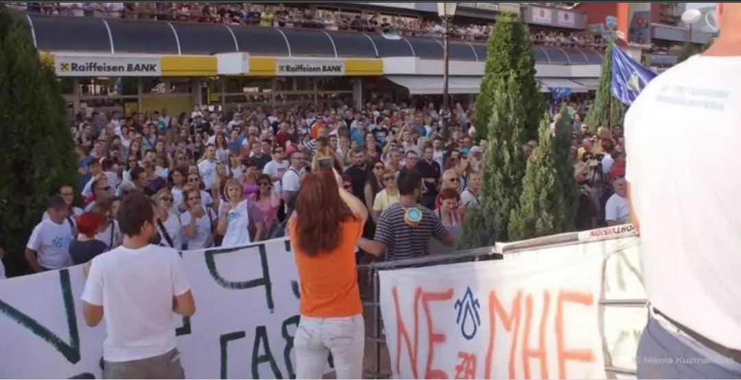
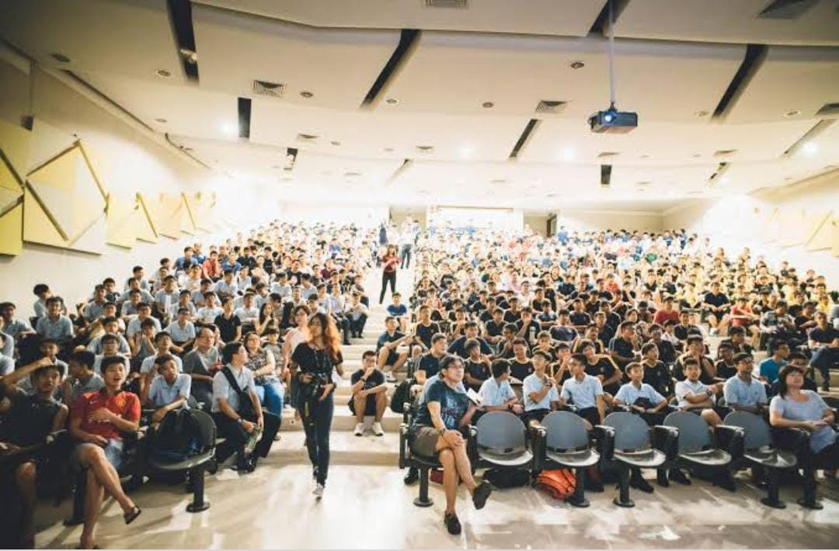
Principal Challenges of Public Participation
1.Costly
A major internal challenge in public participation is inadequate financial resources and human resources. Involving the public in decision-making is time-consuming and costly in terms of money and energy. Starting from the planning process, it needs a lot of time to establish a meaning process that can effectively engage people and their thoughts. Administrators already have a heavy workload, so it is challenging for them to spend more time and energy on public engagement.
2.Lack of skilled facilitator
Some administrators who organise the public engagement process are not equipped with engagement skills. They may also have less experience in public participation. Skilled practitioners are critical to the success of participation as they can facilitate the process, maintain a good relationship with citizens, and generate better results. Although some agencies offer external service, courses or workshops to train the administrators about public participation, they are often expensive and do not take the context into consideration.

Slide 9
3 Low efficiency
Participating in public meetings is usually not a priority for people when competing with work, household or other daily obligations. Less time is available after completing daily chores, which makes the engagement more difficult. Furthermore, traditional public engagement approaches generally take a longer time with less satisfying results, leading to an even lower rate of participation. Thus, increasing the efficiency of the participation approaches without compromising the outcomes is an urgent need.
4 Not interested in participation
Another external factor of the low participation level is that the public shows less interest in public matters. How to motivate the citizens, stimulate their interests, and obtain meaningful inputs are the questions that practitioners need to answer. To increase the participation level, we can provide multiple ways and opportunities to them. For example, encouraging the public to participate in public issues related to their daily life or offering rewards for participation are the possible solutions.
5 Language barrier
In the context where it has a variety of nationalities, culture or language barrier is always a problem. People who do not master the local language are often excluded from public meetings simply due to the language barrier. Especially in an international community, language is the main reason for excluding immigrants and foreigners as one of the marginalised groups.

Slide 10
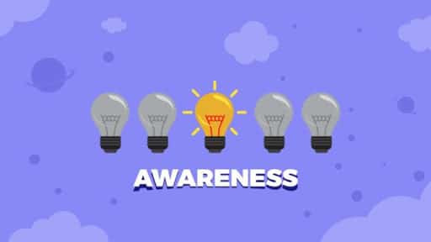


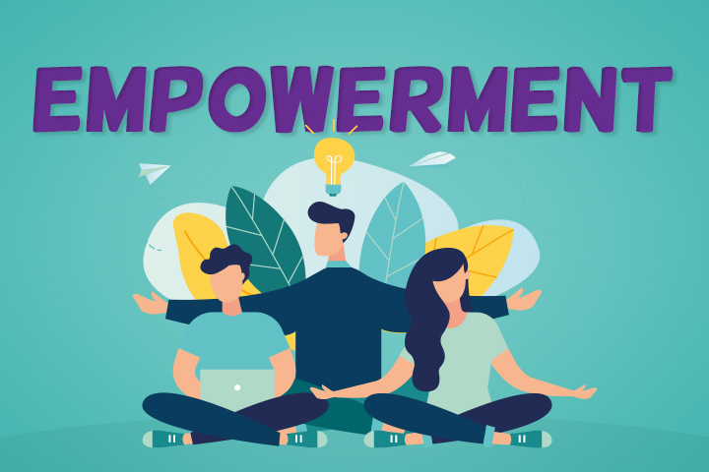
SOLUTIONS TO LACK OF PUBLIC PARTICIPATION

Slide 11

“NO ONE CAN DO EVERYTHING…. BUT WE CAN ALL DO SOMETHING!

